Slide 1
User Access Review Project
Presented by:
Mr Monale Tabane
VUT IT. Services
10/03/2025

Slide 2
^{CONTENTS}
1. | What User Access review Project | 3
2. | ITS Menu Options Application | 4
3. | iEnable Access Control Functionality | 5-8
4. | Application Routing Email Notification | 9
5. | Copying User Access | 10
6. | What should be in place for the module to work? | 11
7. 8. 9. | Setting Up Automated Access Review Reports Revoking Access to be given to a Personnel Member Questions | 12-15 16-18 19

Slide 3
User Access Review Project
What is User Access Review Project?
The Users Access Project was established at the Technical User Forum in 2024 in Stellenbosch. The primary objective of the project is to raise awareness about the standard Access Control module accessible through the iEnabler platform. The project focuses on the effectiveness of the module in managing user access for ITS. It delves into the features and functionalities of the Access Control module, as well as the process of conducting access reviews for subsystems to ensure compliance with audit requirements. Additionally, the project identifies areas for potential enhancements and improvements to the module.

Slide 4
User Access Review Project
ITS Menu Options Application
Previously, the ITS Access Application process was manual.
Application Forms had to be completed by applicants and signed by three individuals.
The manual process was time-consuming and delayed granting access.

Slide 5
User Access Review Project
iEnable Access Control Functionality
iEnabler Access Control streamlined processes.
Faster application processing.
Applications follow a sequential approval route: Line Manager -> System Owner -> IT.
Users are granted access in less than 5 minutes.

Slide 6
User Access Review Project
iEnable Access Control Functionality
iEnabler Access Control streamlined processes.
Faster application processing.
Applications follow a sequential approval route: Line Manager -> System Owner -> IT.
Users are granted access in less than 5 minutes.
Who is Using this Functionality?
Who is planning to use it?
Who will never use it?

Slide 7
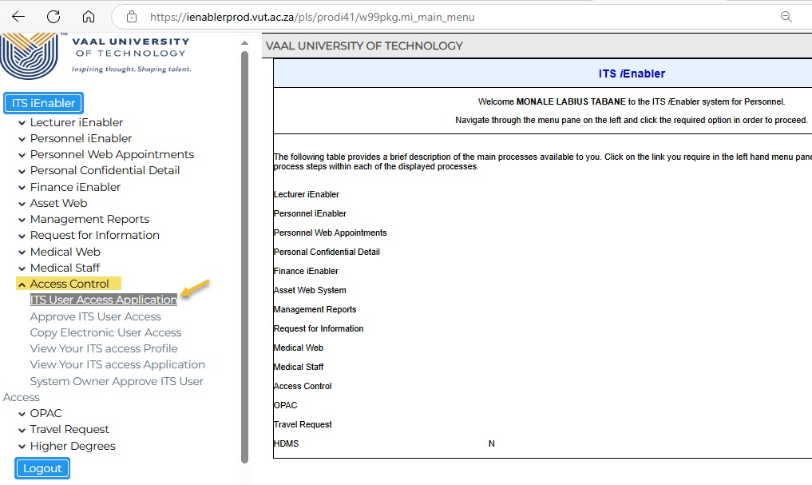
iEnable Access Control Functionality
User Access Review Project

Slide 8
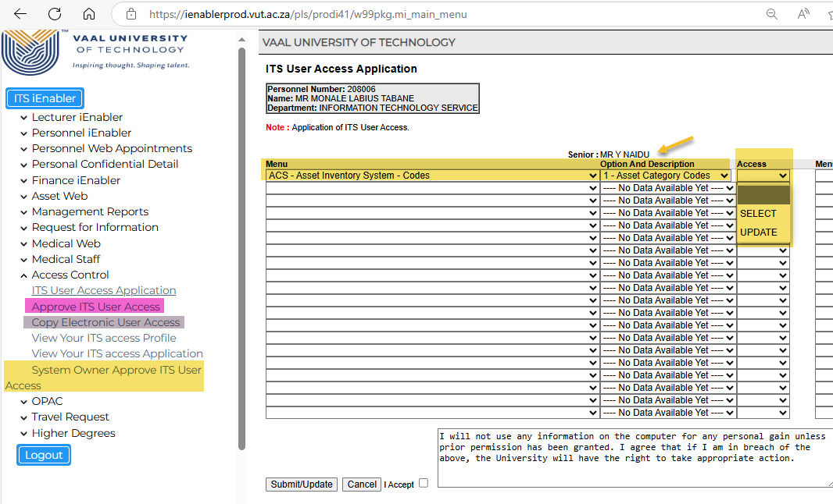
iEnable Access Control Functionality
User Access Review Project

Slide 9
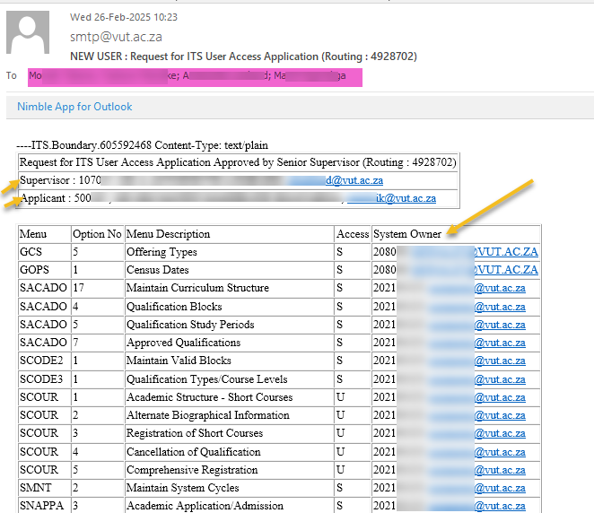
Application Routing Email Notification
User Access Review Project

Slide 10
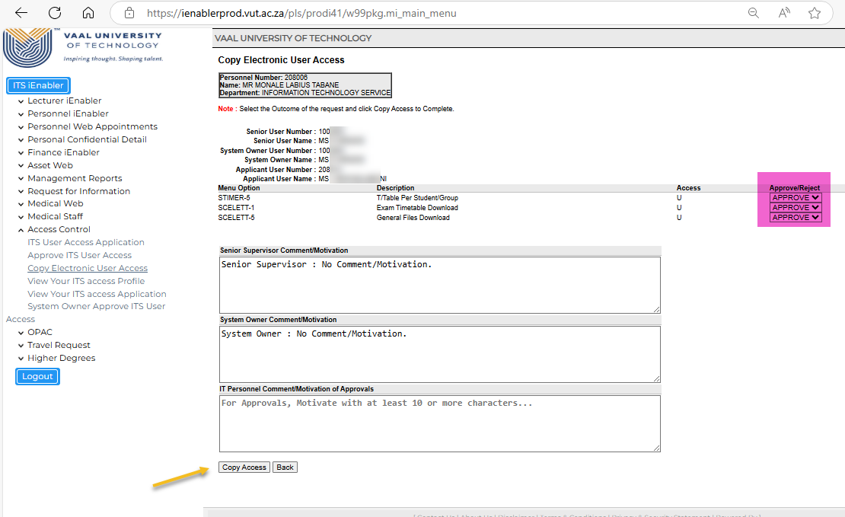
Copying User Access
User Access Review Project

Slide 11
User Access Review Project
What should be in place for the module to work?
Both Applicant and Line Manager must be active staff members on Pbop-1
Both Applicant and Line Manager must have email addresses linked on Pbop-14
Both Applicant and Line Manager must exist on User-5.
Function Code for the User must exist on Users-2
Function code must be linked to the user on Users-3.

Slide 12
User Access Review Project
Setting Up Automated Access Review Reports
Setup System owners on Users-1b5(System Detail)
Make sure all Menu Options are linked to System Owners on Users-43(Export/Import)
Generate the Access report on Usersr-5
Create a Scheduled Job for the report on Batch-8
Choose the frequency for your report. E.g. Monthly or Weekly

Slide 13
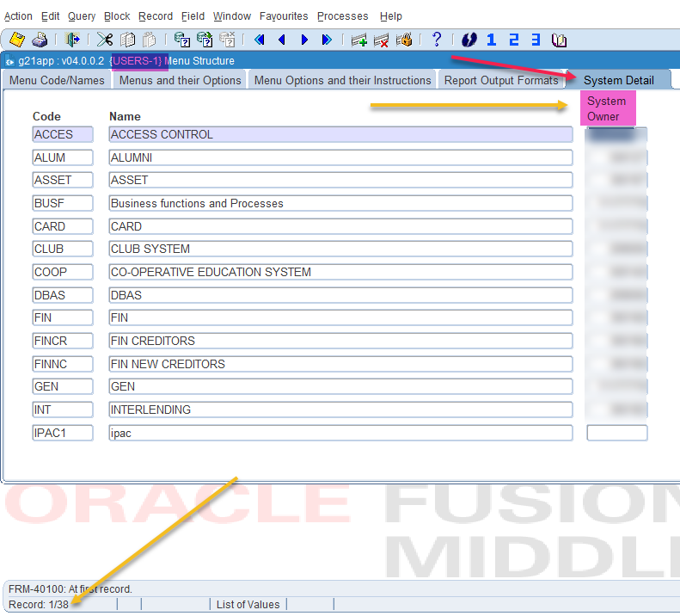
Setting Up Automated Access Review Reports
User Access Review Project

Slide 14
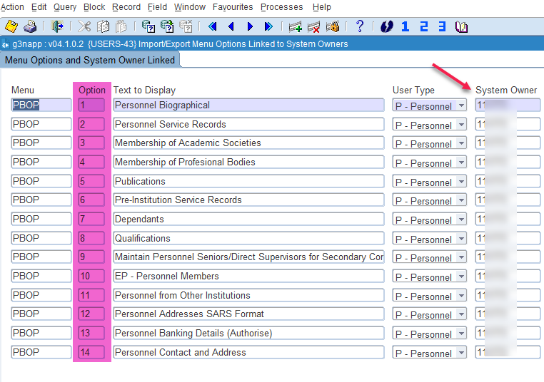
Setting Up Automated Access Review Reports
User Access Review Project

Slide 15
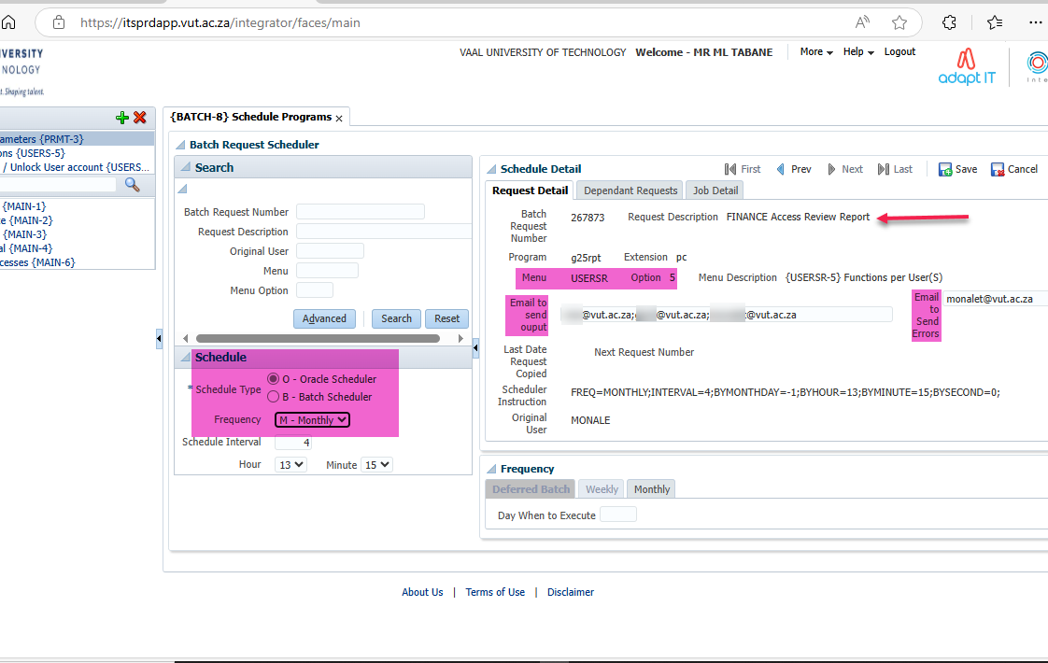
Setting Up Automated Access Review Reports
User Access Review Project

Slide 16
User Access Review Project
Revoking Access to be given to a Personnel Member
Functionality Exists to Revoke Access when:-
The Personnel Member Resigns.
There is a change in the post code when a new Service Record is created.
SOD ‘AC’, Subsystem ‘HR’ must be set to ‘Y’es on GCS2-11 for this to work
Four Routing Types are used for notifications setup on GROU-1:
FREM – 1st Reminder
SREM – 2nd Reminder
TREM – 3rd Reminder
LREM – Last Reminder (when SYSDATE = Service Record End Date)
Service Record End Date Check(USERS-45) and Maximum Days check(USERS-46) must be scheduled on BATCH-8 to run Daily.
Use GOPS-21 to setup No. of Days notifications should start and how long the record must be on the system before it is deleted.

Slide 17
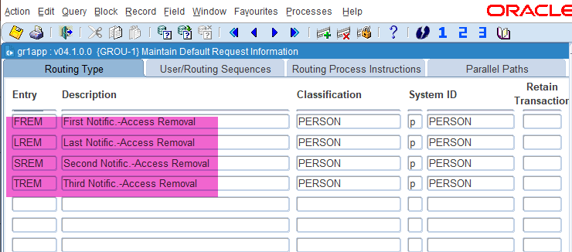
User Access Review Project
Revoking Access to be given to a Personnel Member

Slide 18
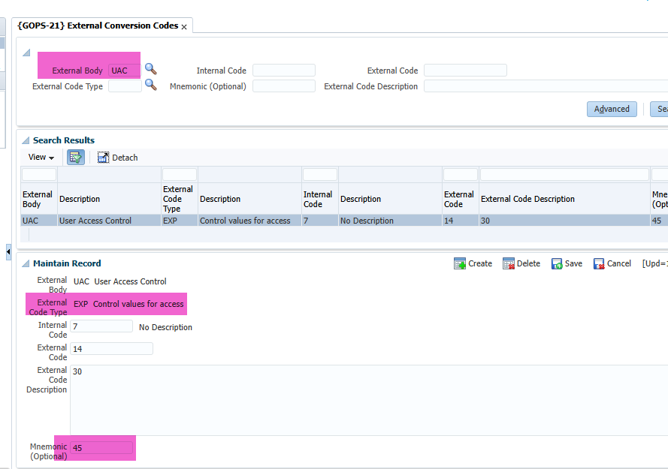
Revoking Access to be given to a Personnel Member
User Access Review Project

Slide 19
User Access Review Project
Questions..
Contact me on monalet@vut.ac.za for further engagements….

